Slide 1
Ms. Kat’s Social Media Tutorial

Slide 2
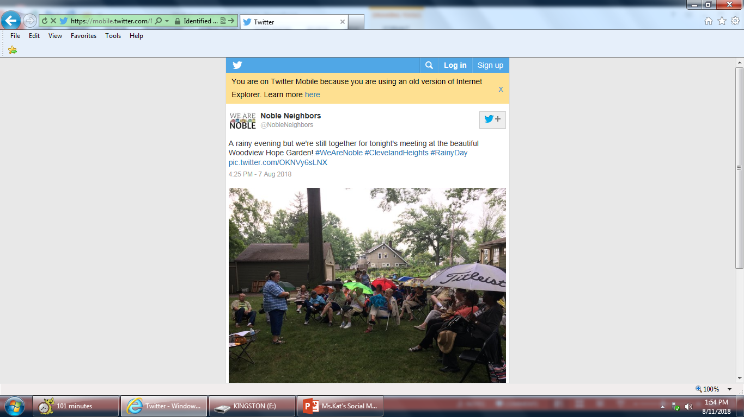
Basic Intro to Social Media
What is Social Media?
Merriam-Webster Dictionary defines Social Media as: forms of electronic communication (such as websites for social networking and microblogging) through which users create online communities to share information, ideas, personal messages, and other content (such as videos). You can use social media networking applications on desktop computers, tablets and mobile devices.
Social Media networks:
Twitter: An online social networking service where users share news and other types of information in the form of 280 (max) character tweets via text, pictures and video. EX:

Slide 3
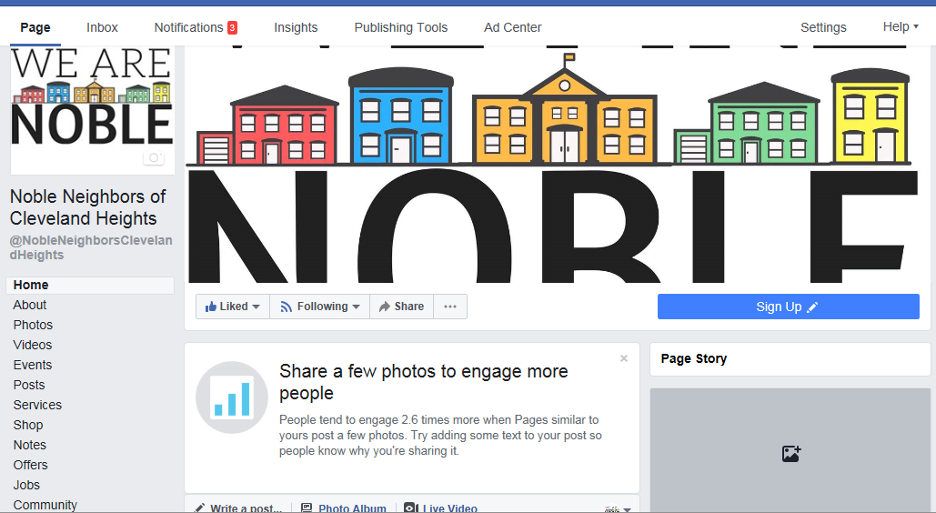
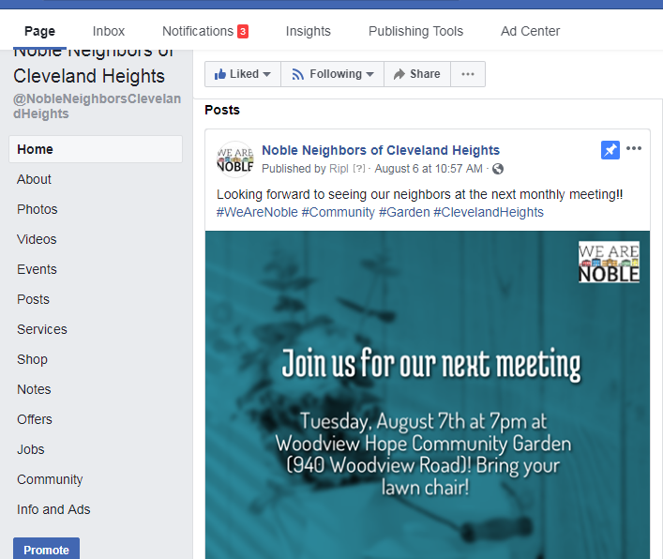
Basic Intro to Social Media
Facebook: Online social media network that started as an application for college students but eventually grew to being used by millions of people worldwide. Users create personal profiles to share information with their Facebook “friends” which can consist of personal friends, people you meet the social networking app, family members and associates. Businesses (large and small) and organizations create Facebook Pages to promote their business to the general public. Facebook Groups are online communities (of various topics) that users create which can be public, private or secret. Creators of these groups invite others to join. You must have a personal account in order to create and be an admin of Facebook Pages and Groups.
Facebook Page:

Slide 4
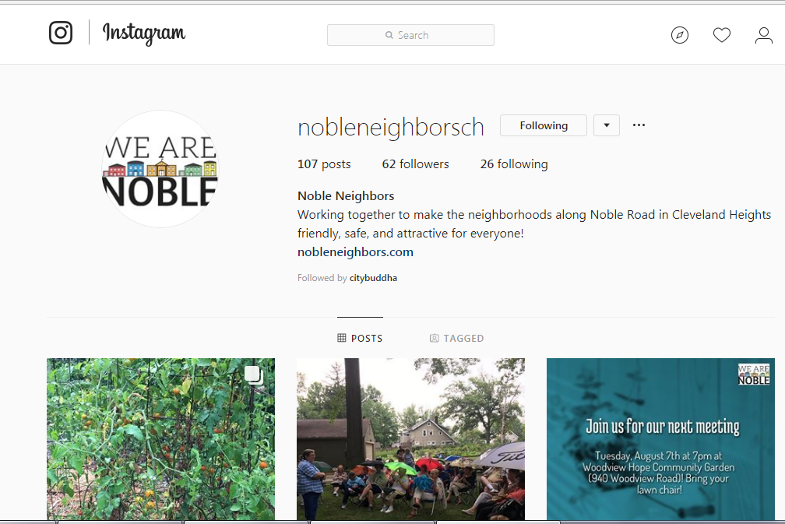
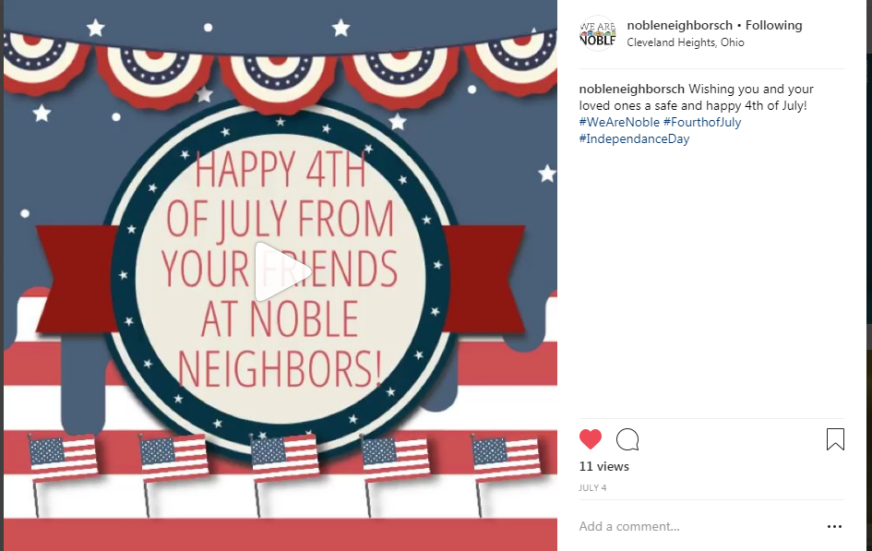
Basic Intro to Social Media
Instagram: A photo and video sharing social network owned by Facebook. Once you create your Instagram profile you can follow and comment on other pages of interest. Instagram Ex:

Slide 5
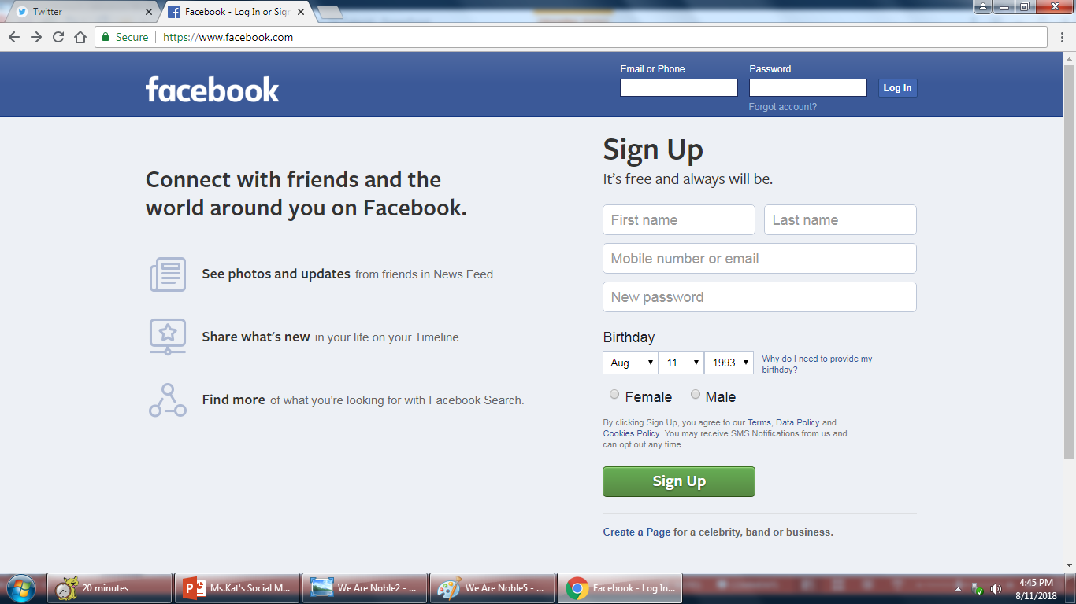
How To Create (Facebook Personal Account)
In order to use Facebook you will need to create a personal account. As you can see in the photo below, they give you step by step instructions on how to set up your account. Once you’re in you can search for friends and family as well as follow the pages for your favorite business, entertainers, television shows and more.

Slide 6
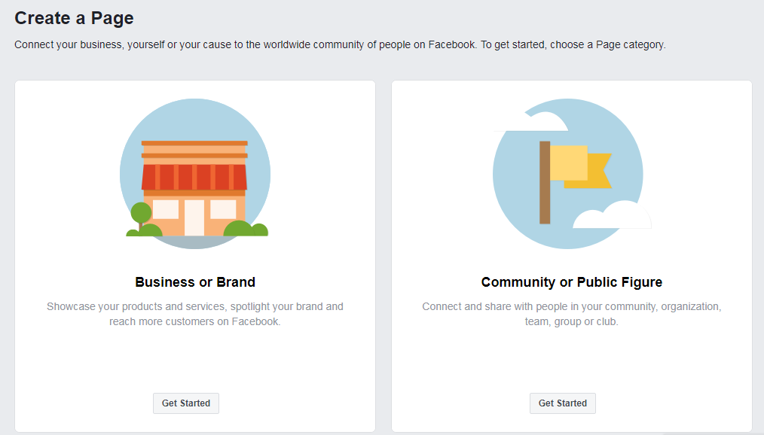
How To Create (Facebook Page)
Facebook Page: At the top of your personal profile click the upside down triangle. In the drop down menu click CREATE PAGE. This will take you to the Create a Page area. Choose the type of Page you want to create. For the sake of this tutorial we’ll choose Community or Public Figure. Click on Get Started.

Slide 7
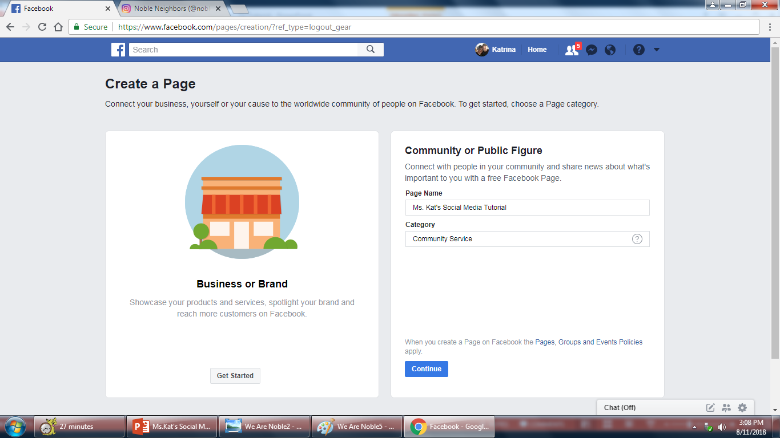
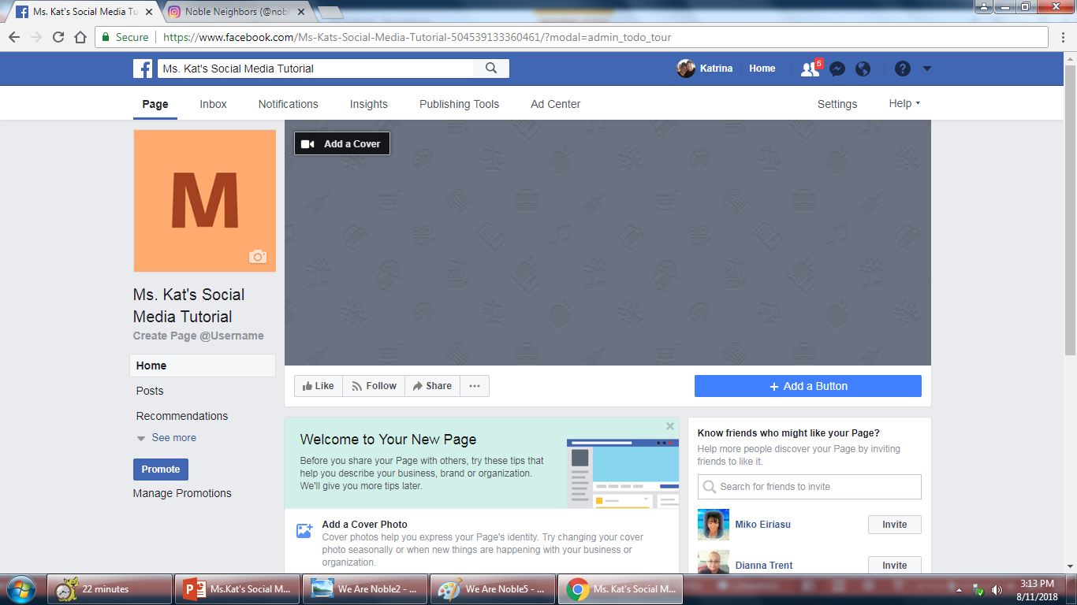
How To Create (Facebook Page)
Next you want to choose a name for your Page and category. Once you’re done click Continue. The next step is to upload a profile and cover picture, but you do have the option to skip that step until you are ready to upload your pictures.

Slide 8
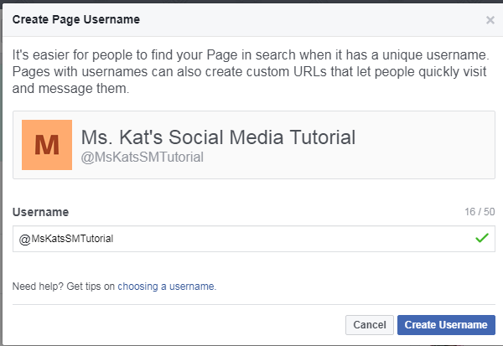
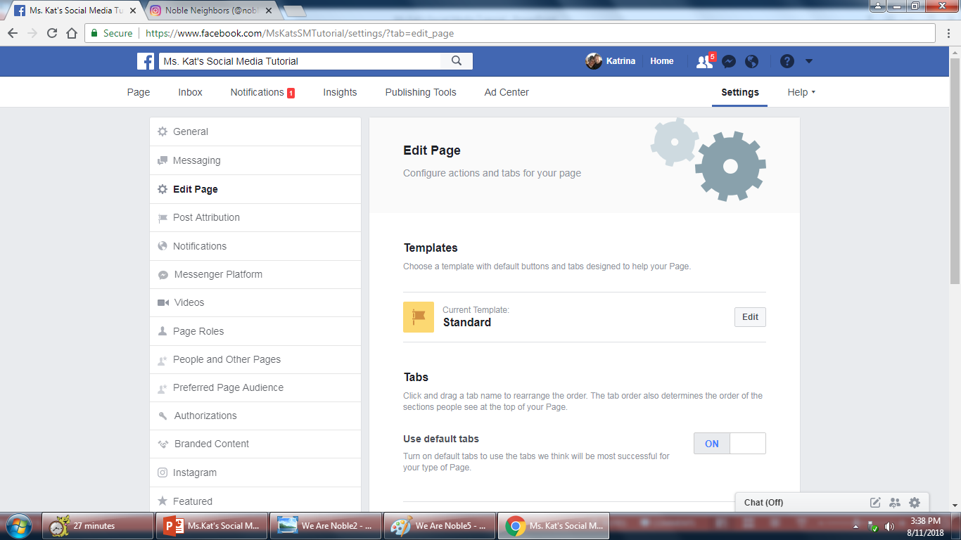
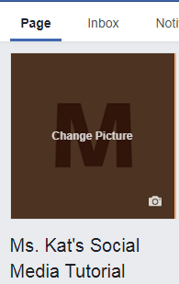
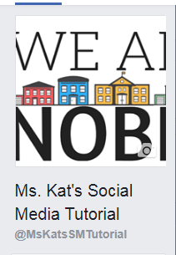
How To Create (Facebook Page)
Once your Page is up you will be able to add a description and create a username which will generate a URL for your Page. All editing can be done by clicking on Settings and choosing from the various menu options.
Adding your profile photo: Click on the small camera located in the bottom right corner of the box. When the drop down menu appears click on the upload photo option. Choose your photo and click save. You will do the same for your Facebook cover photo.

Slide 9
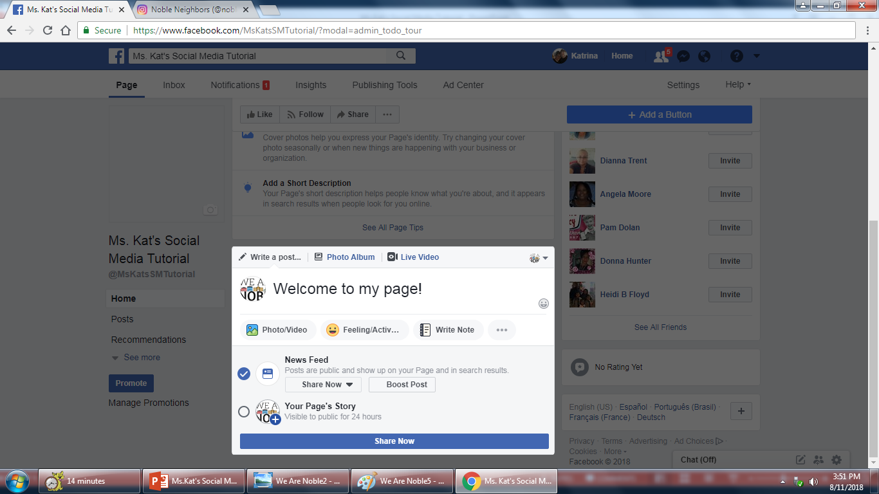
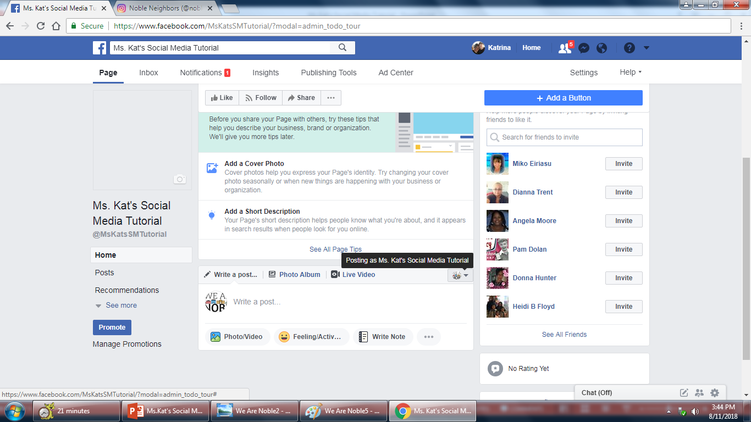
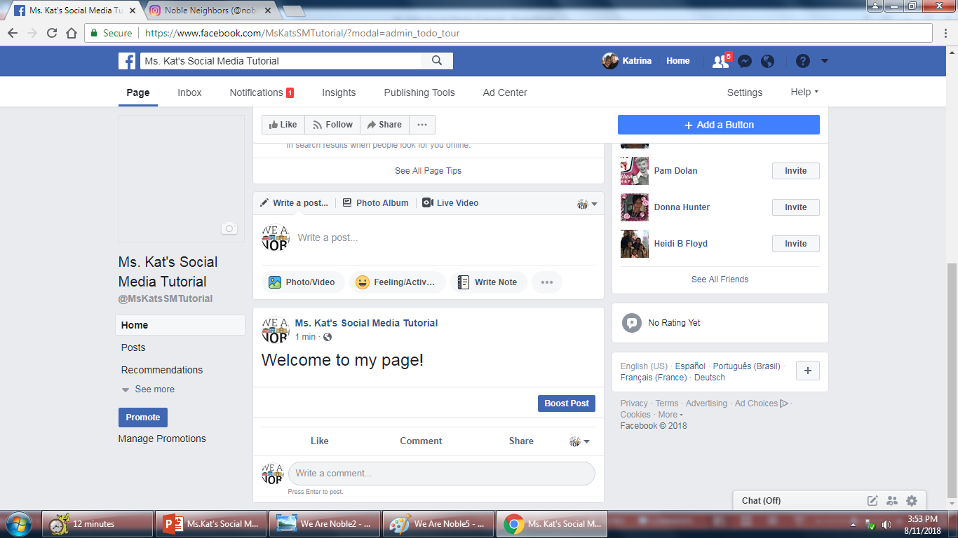
How To Create (Facebook Page)
Posting: You can post as your Facebook Page or as yourself (your personal page). Start typing in the box that says Write a post. After typing your message or adding your photo or video click Share Now and your post has now gone public.

Slide 10
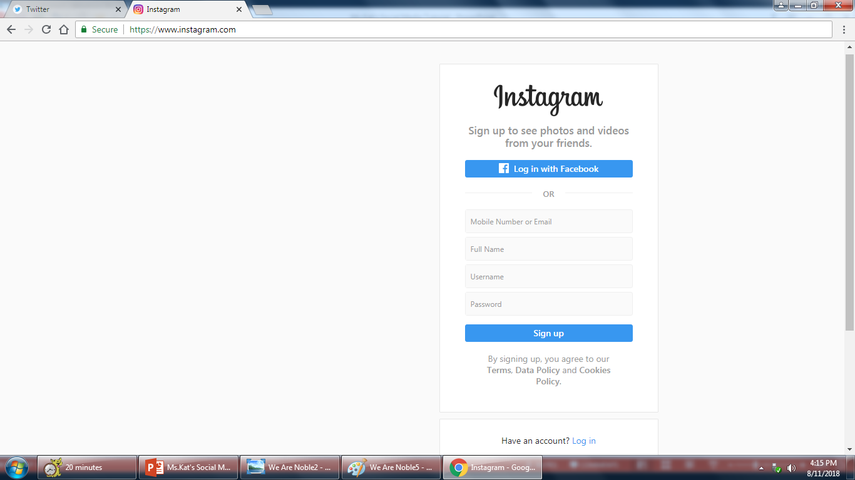
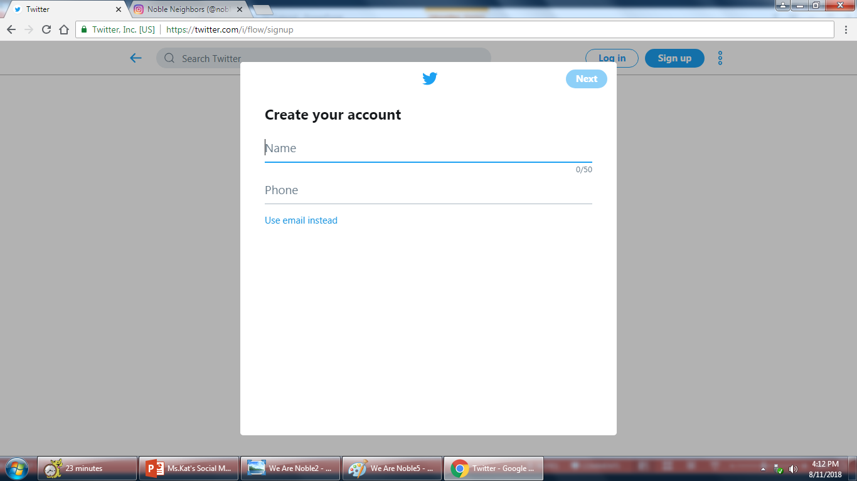
How To Create (Twitter and Instagram Page)
I’m not going to into as great of detail as I did for Facebook. They walk the new user through the set up process pretty easily. The instructions will tell you everything you need to set up your account.

